Slide 2

J-K Flip-Flop
Modified version of S-R Flip-Flop.
Enable is replaced with clock.
Invalid Condition is removed
Figure: Logic Diagram of J-K Flip-Flop

Slide 3
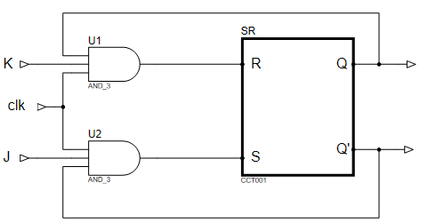
JK Flip Flop
Q
0
0
Q
1
0
Q
1
Q
1
Q
Figure: Logic Diagram of J-K Flip-Flop

Slide 4
J-K Flip-Flop (SET condition) let Q’=1
Truth Table of SR Flip Flop
0
S | R | Q
0 | 0 | Hold
0 | 1 | 0 (Reset)
1 | 0 | 1 (SET)
1 | 1 | Invalid
0
0
1
1
Q = 1
1
0
1
Figure: Logic Diagram of J-K Flip-Flop

Slide 5
J-K Flip-Flop (HOLD condition) previously Q=1 Q’=0
Truth Table of SR Flip Flop
1
S | R | Q
0 | 0 | Hold
0 | 1 | 0 (Reset)
1 | 0 | 1 (SET)
1 | 1 | Invalid
0
0
0
1
0
1
1
0
0
0
0
1
0
0
Figure: Logic Diagram of J-K Flip-Flop

Slide 6
J-K Flip-Flop (RESET condition) previously Q=1 Q’=0
Truth Table of SR Flip Flop
1
0
S | R | Q
0 | 0 | Hold
0 | 1 | 0 (Reset)
1 | 0 | 1 (SET)
1 | 1 | Invalid
1
1
1
1
0
1
0
1
0
0
0
0
0
Figure: Logic Diagram of J-K Flip-Flop

Slide 7
J-K Flip-Flop (Toggle condition) previously Q=0 Q’=1
Truth Table of SR Flip Flop
0
S | R | Q
0 | 0 | Hold
0 | 1 | 0 (Reset)
1 | 0 | 1 (SET)
1 | 1 | Invalid
0
1
0
1
0
0
1
1
1
1
0
0
1
1
Figure: Logic Diagram of J-K Flip-Flop

Slide 8
Characteristics of J-K Flip-Flop
Characteristics Table:
JK Flip Flop Characteristics
Q(t) | J | K | Q(t+1)
JK
J | K | Q
0 | 0 | Hold
0 | 1 | 0 (Reset)
1 | 0 | 1 (SET)
1 | 1 | Toggle
Q(t)
00 01 11 10
0 | 0 | 0
 |  | 1 | 1
1 |  |  | 1
0 (Hold)
0
1
0 | 0 | 1
0 (reset)
0 | 1 | 0
1 (Set)
1 (Toggle)
0 | 1 | 1
Characteristics equation:
Q(t+1)=JK+ K’Q(t)
1 (Hold)
1 | 0 | 0
0 (reset)
1 | 0 | 1
1 (Set)
1 | 1 | 0
1 | 1 | 1
0 (Toggle)

Slide 9
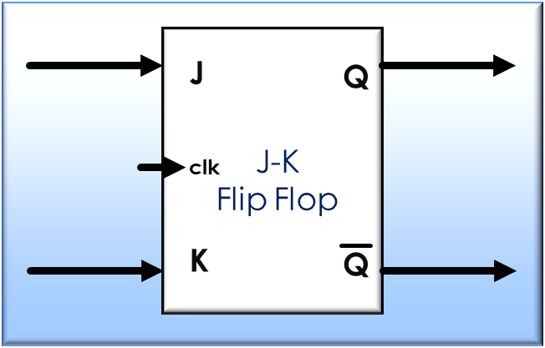
J-K Flip Flop
clk
time
Block diagram of J-K Flip Flop
J
J | K | Q
time
K
0 | 0 | (Hold)
time
0 | 1 | (Reset)
Q
1 | 0 | (Set)
time
1 | 1 | Toggle
Timing diagram of a Gated JK Flip-Flop
Characteristics table of J-K Flip Flop

Slide 10
T Flip-Flop
T
Figure: Logic Diagram of T Flip-Flop

Slide 11
T Flip-Flop
Characteristics table
of J-K Flip-Flop
J | K | Q
0 | 0 | (Hold)
Characteristics table of T Flip-Flop
Hold
Q
Q
Toggle
0 | 1 | (Reset)
K
J
0
1
T | Q
J-K
Flip Flop
1 | 0 | (Set)
clk
1 | Toggle
1 | 1 | Toggle
0
T
1
0 | HOLD
0
1
Block diagram of T Flip Flop

Slide 12
Characteristics of T Flip Flop
D Flip Flop Characteristics
Characteristics Table:
T | Q
0 | HOLD
1 | TOGGLE
Q(t) | T | Q(t+1)
T
Q(t)
0 1
 | 1
1
0 | 0
0
1
0 (HOLD)
0 | 1
1 (TOGGLE)
1 (HOLD)
1 | 0
0 (TOGGLE)
Characteristics equation:
Q(t+1) = T Q(t)’ + T’ Q(t)
1 | 1

Slide 13
T Flip-Flop
Block diagram of T Flip Flop
Q
Q
clk
T
T
Flip Flop
time
clk
T
time
Characteristics table of T Flip-Flop
Q
T | Q
Timing diagram of a Gated T Flip-Flop
time
1 | Toggle
0 | HOLD

